Slide 1
Archaeoastronomy
Models of the solar system
The scientific method

Slide 2
Astronomy
A History

Slide 3
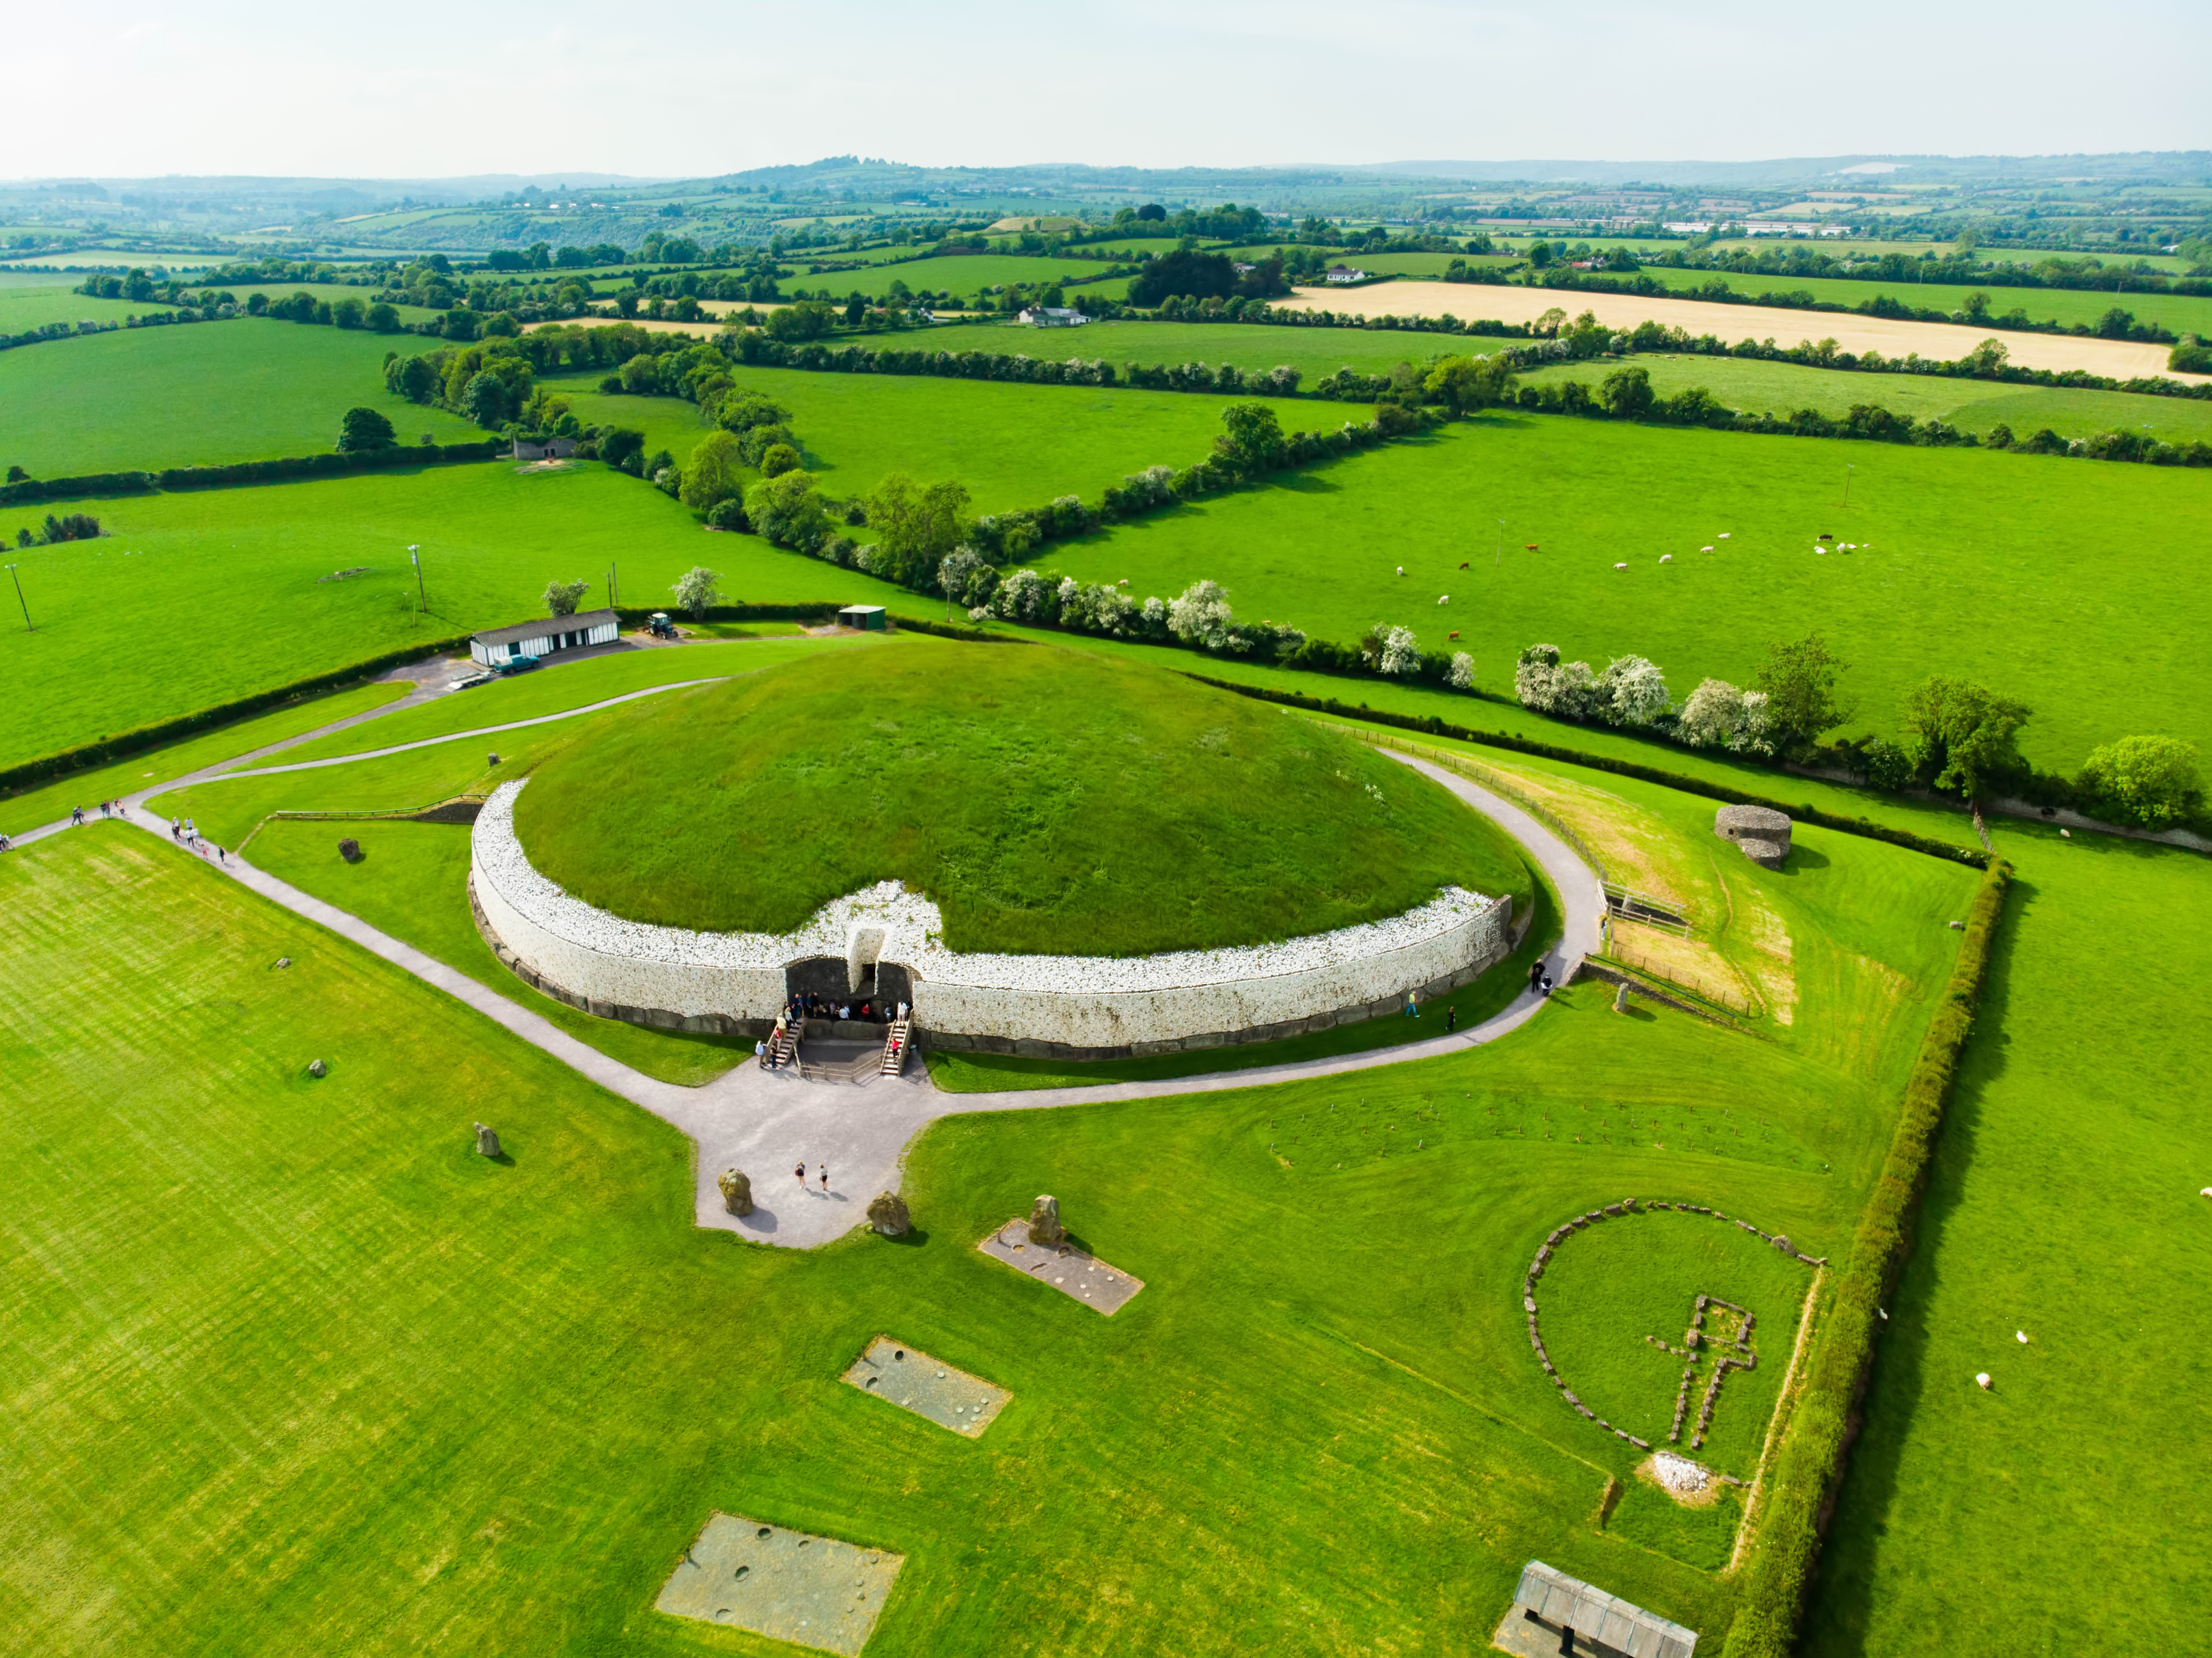
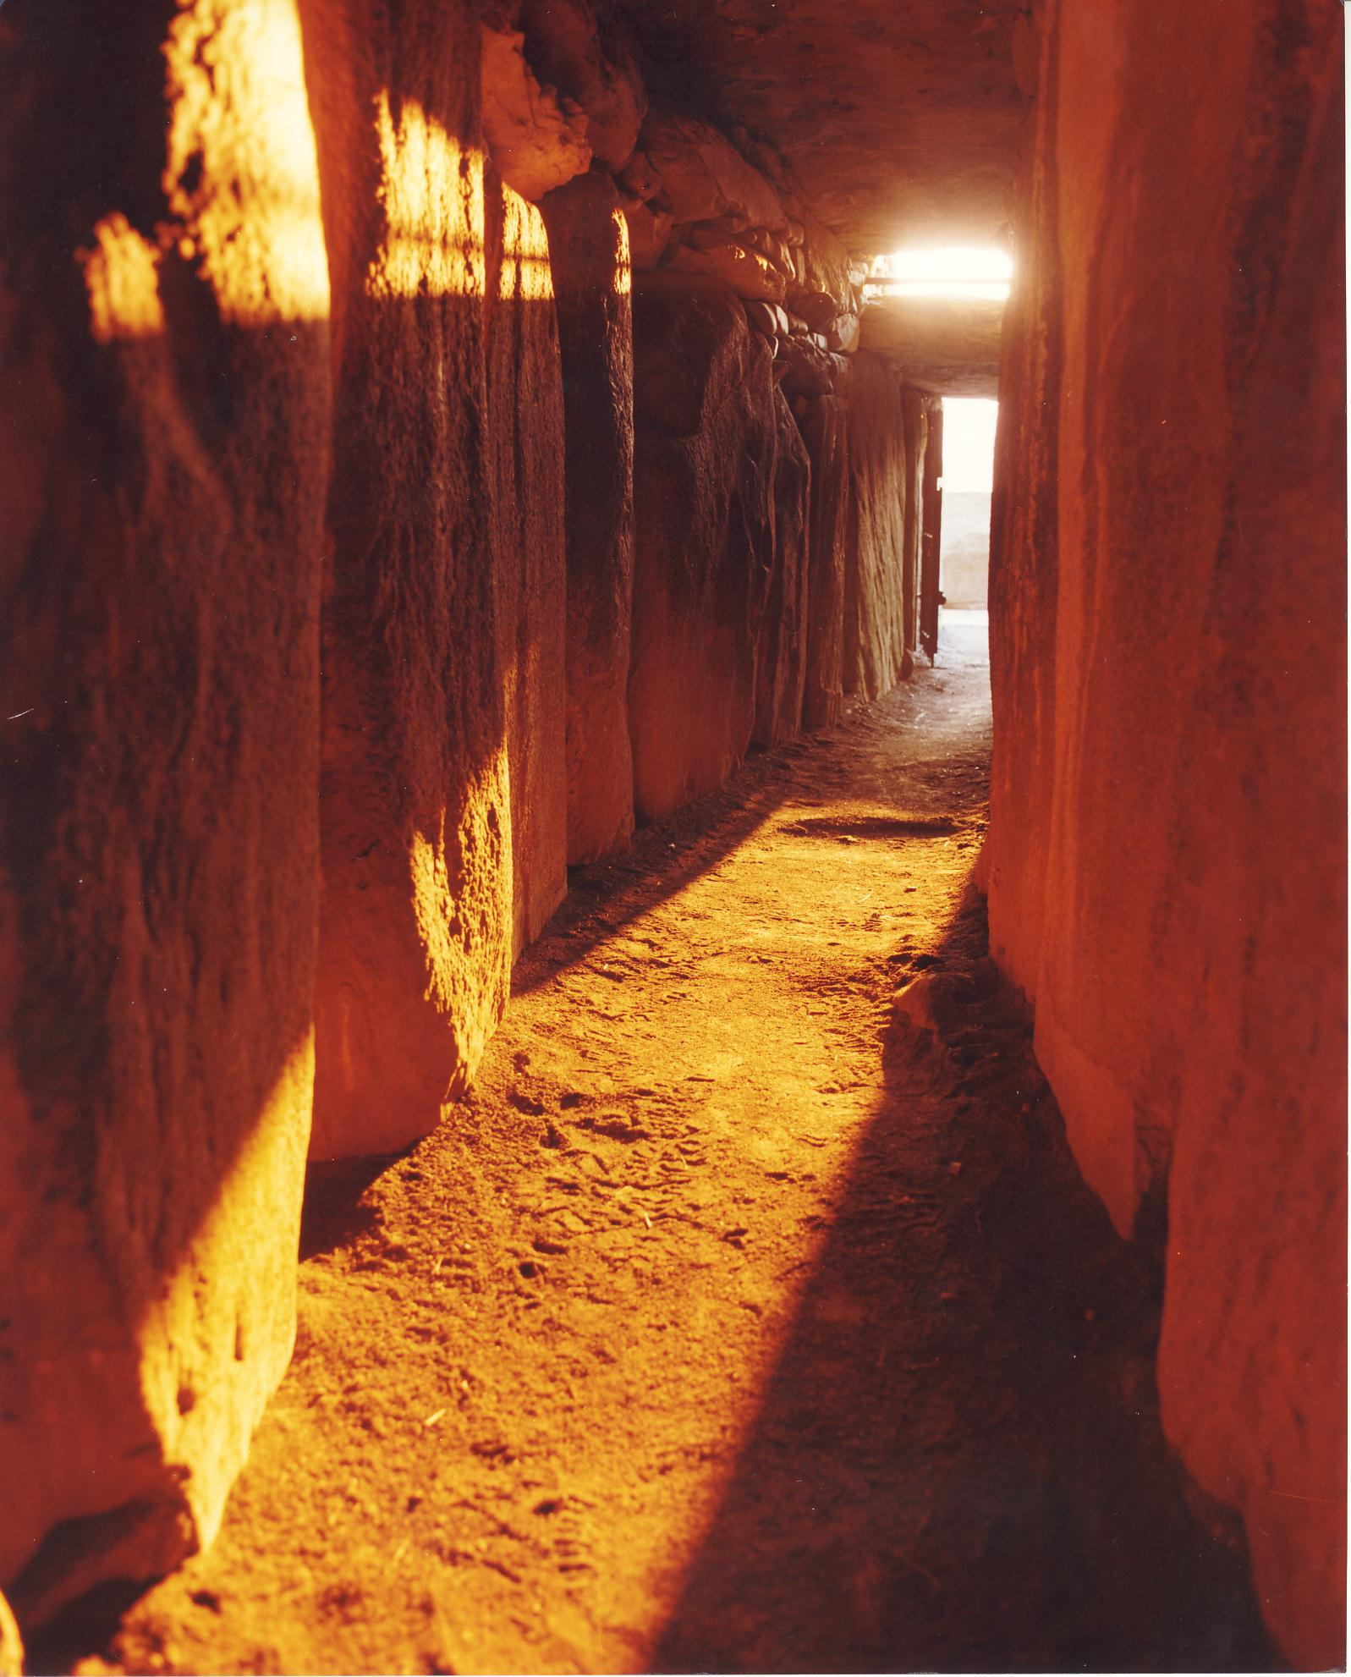
Archaeoastronomy
- The study of how celestial phenomena influenced ancient cultures
National Monuments Division
NMStudio
Notes:
Archaeoastronomy is the study of how celestial events and the night sky influenced primarily ancient cultures.
Here is an image of a Neolithic Tomb in Newgrange, Ireland. Neolithic because it was build at the end of the stone age.
Its entrance contains a door with another opening above it which lets light reach the inner chamber at sunrise near the winter solstice.
Left: NMStudio
Right: National Monuments Division, Office of Public Works, Ireland
National Geographic Video:
https://www.youtube.com/watch?v=KVXWZkwV0RQ

Slide 4
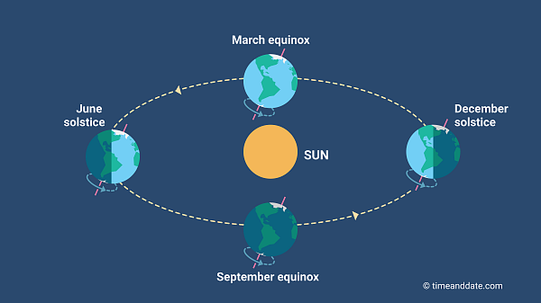
Solstice
The time when the sun is at its highest or lowest point in the sky, giving us the longest (summer) and shortest (winter) days of the year
Notes:
This is the definition of a solstice. There are two every year one in June and one in December. If the northern hemisphere has its summer solstice in June (notice the Earth’s northern hemisphere is tilting towards the sun) then the southern hemisphere has its winter solstice (the southern hemisphere is tilted away from the sun). We’ll look at how this related to seasons in more detail later.

Slide 5
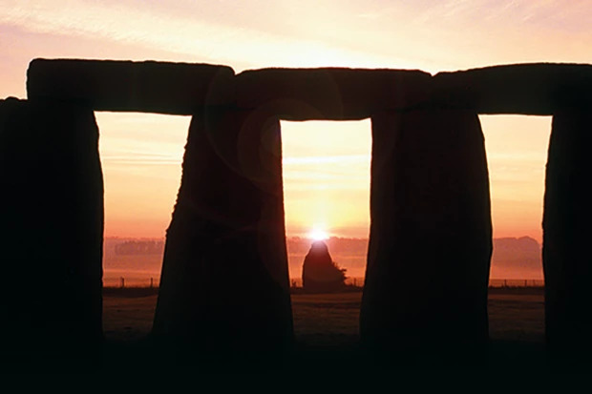
Stonehenge
Galaxy Picture Library / Alamy Stock Photo
Notes:
Stonehenge has had multiple iterations with the earliest elements dating to Mesolithic (pre-Neolithic) times.
Its original axis points towards the rising sun at the summer solstice and the setting sunset at the winter solstice.
Image: Summer solstice sunrise, the sun is touching the top of the Heel Stone (a Menhir or standing stone) seen through the arches of the Dolmen, Galaxy Picture Library / Alamy Stock Photo

Slide 6
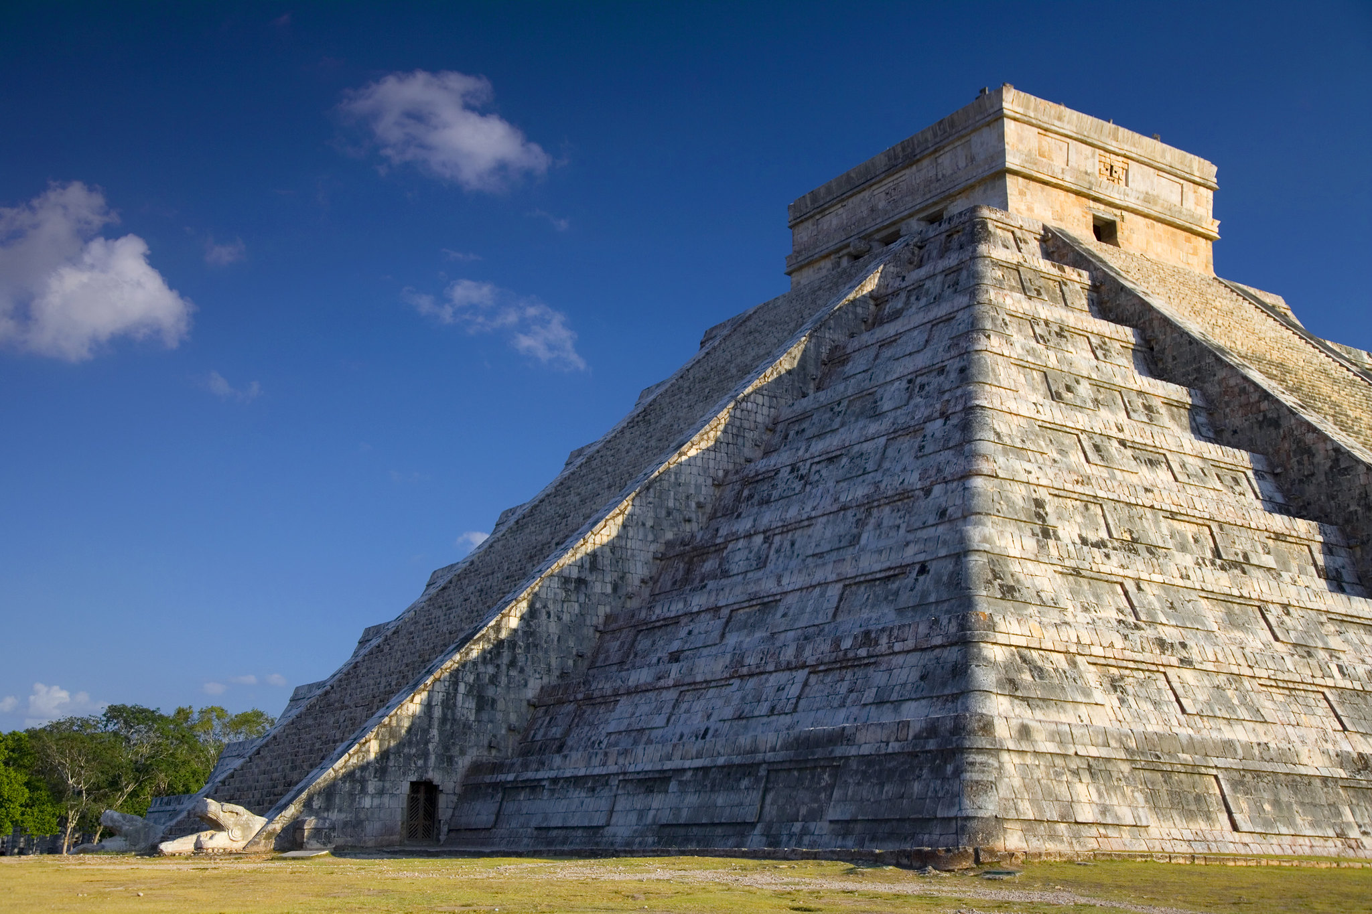
Mayans - Chichén Itzá
Richard Cohen
Notes:
The temple of Chichén Itzá is orientated and built such that on the equinoxes a snake appears to form from the shadow of the temple’s side.
The snake appears to be descending the temple and is a representation of the Mayan god Kukulkan.
Image: Richard Cohen https://www.flickr.com/photos/aboutrichard/5205861649/

Slide 7
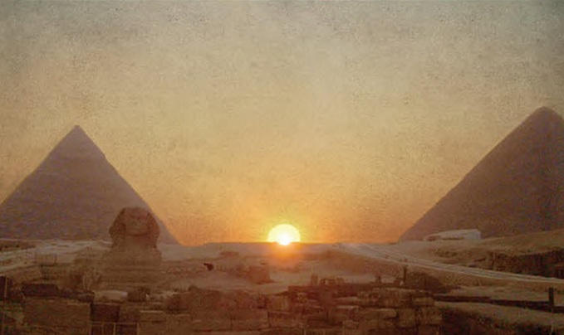
Egypt – Great Pyramids
Guilio Magli – Politecnico di Milano
Notes:
The summer solstice between the Khafra and Khufu pyramids of Giza. The shape formed is the hieroglyph ‘akhet’ which means horizon or rising sun.
The ‘akhet’ hieroglyph is comprised in part by another hieroglyph ‘djew’ which is associated with the afterlife. Of course the pyramids are in fact tombs and Khufu has shafts from the kings burial chamber to the outside night sky which are thought to point to the constellations Sirius and the belt of Orion where gods supposedly came from (remember Pharaohs were considered living gods).
Guilio Magli is an archaeoastronomer at Politecnico di Milano, and has several books and a coursera class on archaeoastronomy.

Slide 8
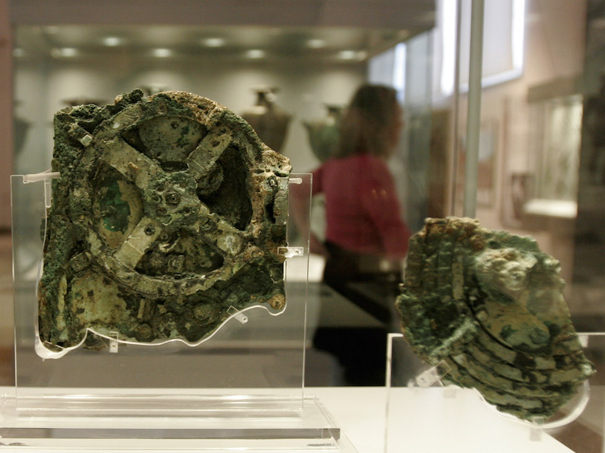
Antikythera mechanism
Thanassis Stavrakis/AP
Notes:
This is an ancient analogue computer using gears developed by ancient Greek scientists to calculate the astronomical positions and timings of eclipses among other events of interest. The image shown is of the main fragment (fragment A) which now resides in the National Archaeological Museum in Athens. There are 82 fragments of the device recovered which have been used to help reconstruct how the device might have worked. The knowledge to make the device was lost until astronomical clocks were made starting in the 11th and 12th centuries CE.
See: http://antikythera-mechanism.gr/

Slide 9
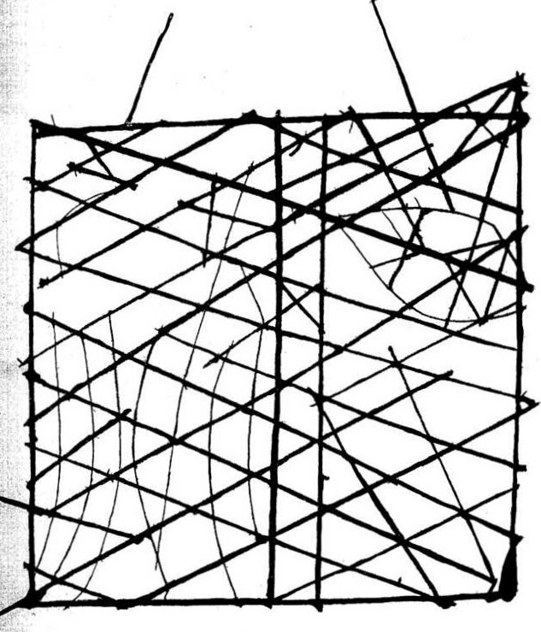
Polynesian Navigation
NZETC
Notes:
Polynesians and possibly Micronesians used navigation devices made out of sticks to show positions of stars, islands, wind, and current directions.
They also had their own ‘star compass’ to help them navigate.
See: https://amedleyofpotpourri.blogspot.com/2018/08/polynesian-navigation.html
Image:
Found here: https://en.wikipedia.org/wiki/Polynesian_navigation#/media/File:Polynesian_navigation_device_showing_directions_of_winds,_waves_and_islands.jpg
Original Source:
http://nzetc.victoria.ac.nz/

Slide 10
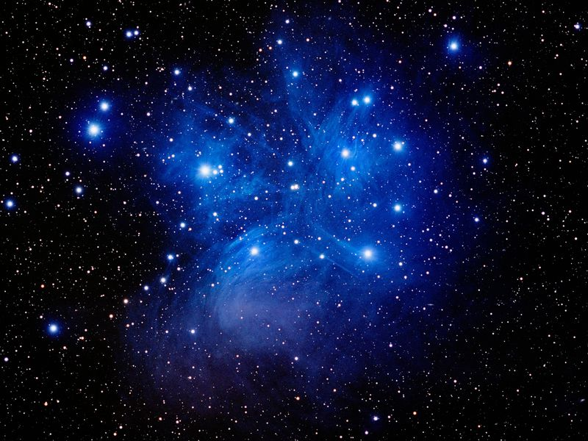
Hawaii - Makahiki
Tony Hallas/Science Faction/Corbis
Notes:
The beginning of the Hawaiian Makahali or ancient New Year festival is timed to coincide with the rise of the star cluster Pleiades (Makali’i) after sunset, usually on the 17th of November.
See: https://apps.ksbe.edu/kaiwakiloumoku/node/601

Slide 11
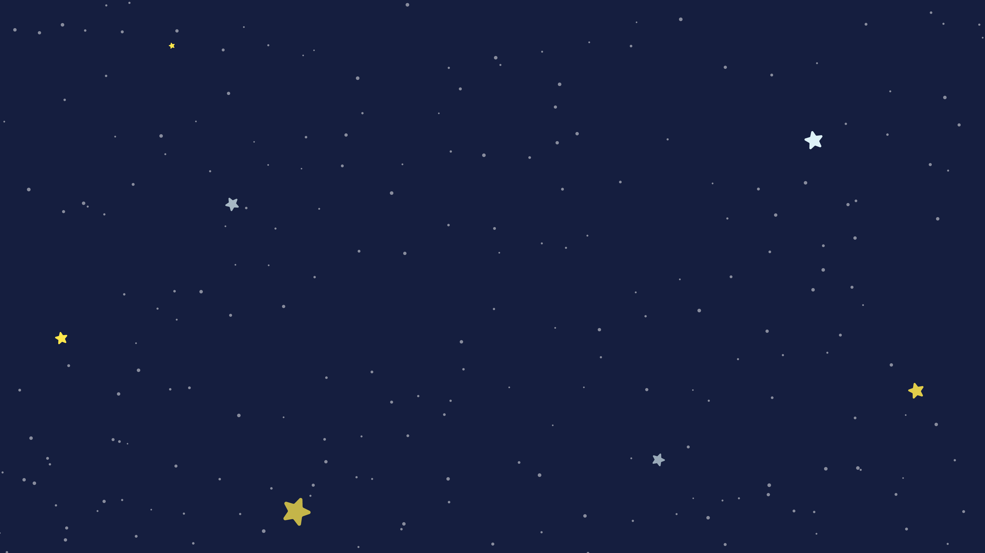
Solar System Models
Each of these famous astronomers/scientists helped improve our model for the solar system by making new observations or taking new data
Ptolemy
Pythagoras
Aristarchus
Copernicus
Tycho
Kepler
Galileo

Slide 12
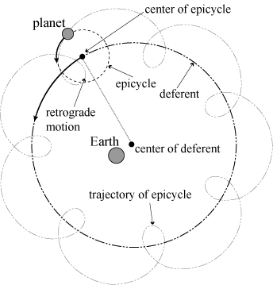
Ptolemy
Guan-Ze Liao
Notes:
The Ptolemy geocentric model. Planets move in circles around circles. Used to explain retrograde motion where a planet moves backwards for a while before moving forwards again. Geocentric means Earth is at the center of the SS (and they believed the Universe).
Image: http://www.mi.sanu.ac.rs/vismath/liao/introduction.html

Slide 13
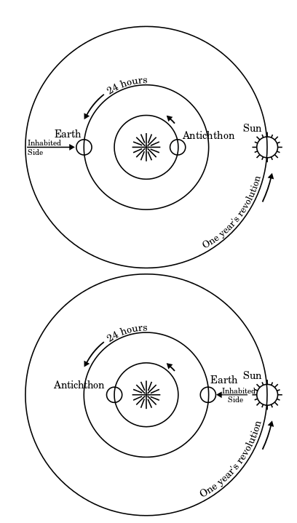
Pythagoras
Guan-Ze Liao/wikimedia
Notes:
Pythagoras suggested the Earth was not at the center but instead there was a central fire not visible from Earth.
Image: https://en.wikipedia.org/wiki/Pythagorean_astronomical_system#/media/File:Antichthon.svg

Slide 14
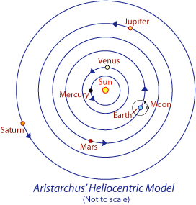
Aristarchus
Notes:
Aristarchus was the first to suggest a heliocentric or sun-centered model. Although his text describing his theory was lost when the Great Library at Alexandria was destroyed. However Archimedes wrote about Aristarchus’ model in his book ‘The Sand Reckoner’.
Putting the sun at the center of the solar system implies you should observe stellar parallax where foreground (nearer) stars appear to move against background ones in the sky over the course of the year.
In Aristarchus’ time it was not possible to detect this parallax.

Slide 15
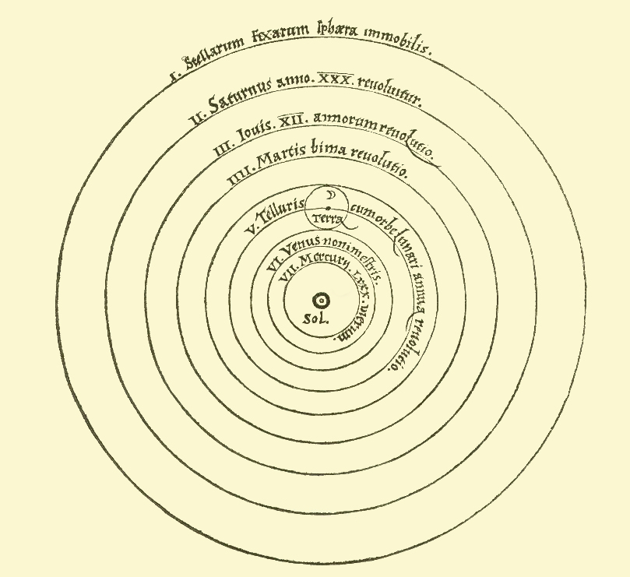
Copernicus
Nicolaus Copernicus
Notes:
The Copernican model of the solar system from his the work De revolutionibus orbium coelestium (On the Revolutions of Heavenly Spheres) 1543.
He introduced 4 new ideas:
1) The Earth is one of several planets revolving around a stationary sun in a determined order.
2) The Earth has three motions: daily rotation, annual revolution, and annual tilting of its axis.
3) Retrograde motion of the planets is explained by the Earth's motion.
4) The distance from the Earth to the Sun is small compared to the distance from the Sun to the stars.
See: https://en.wikipedia.org/wiki/Copernican_heliocentrism

Slide 16
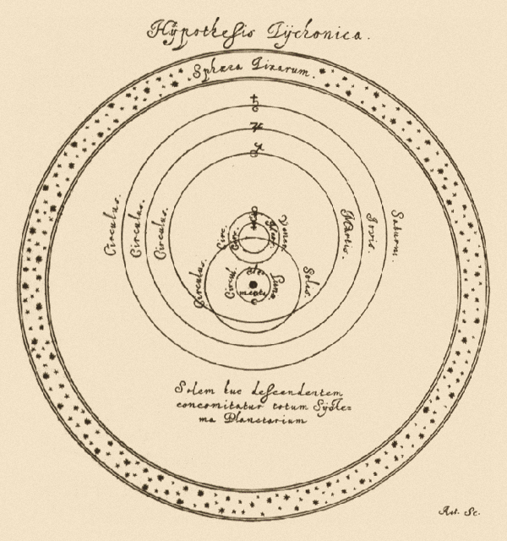
Tycho
Tycho Brahe
Notes:
Tycho Brahe’s model had the Earth at the center with the moon and the stars around the Earth. The sun then orbited the Earth and the planets orbited the sun.
He came up with this model in part because he couldn’t measure stellar parallax so thought the Copernian model to be false.
Image of the Hypothesis Tychonica from Hevelius’ Selenographia 1647 page 163.
See: https://en.wikipedia.org/wiki/Tychonic_system#/media/File:Tychonian.png

Slide 17
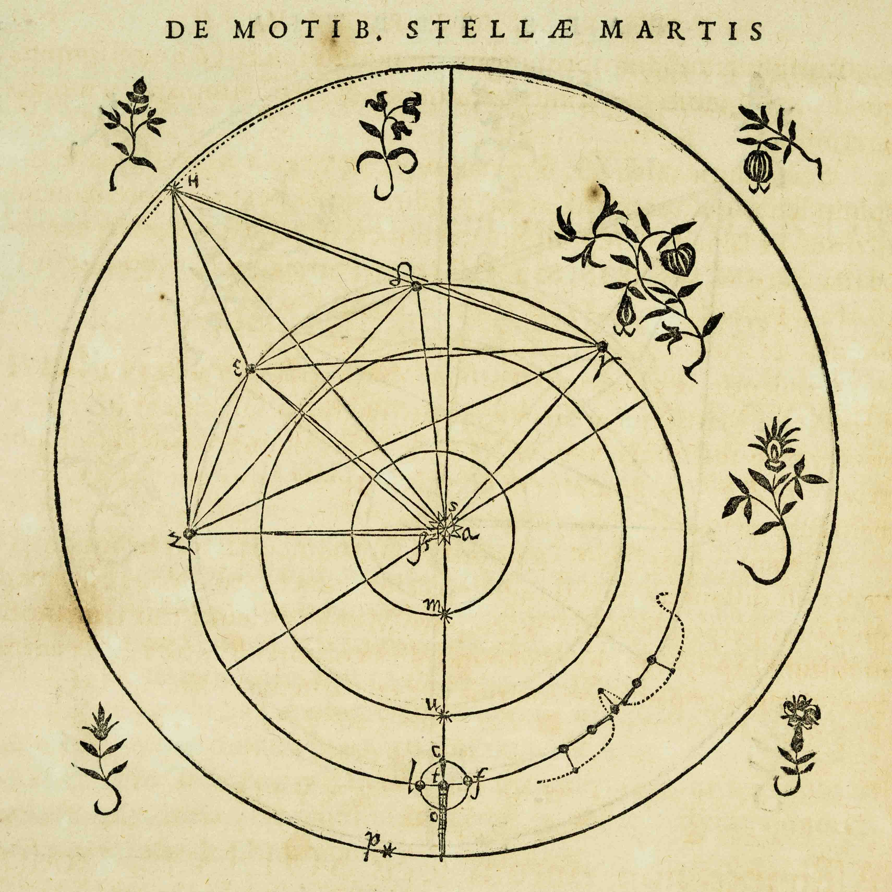
Kepler
Sean Wilkinson
Notes:
Johannes Kepler worked for a period with Tycho Brahe and took over his work when he died. In his work Astronomia Nova he fit observations of Mars to an elliptical orbit not circular.
This illustration from Astronomia Nova shows the inner solar system.
Image from: https://ecommons.udayton.edu/rosebk_images/83/

Slide 18
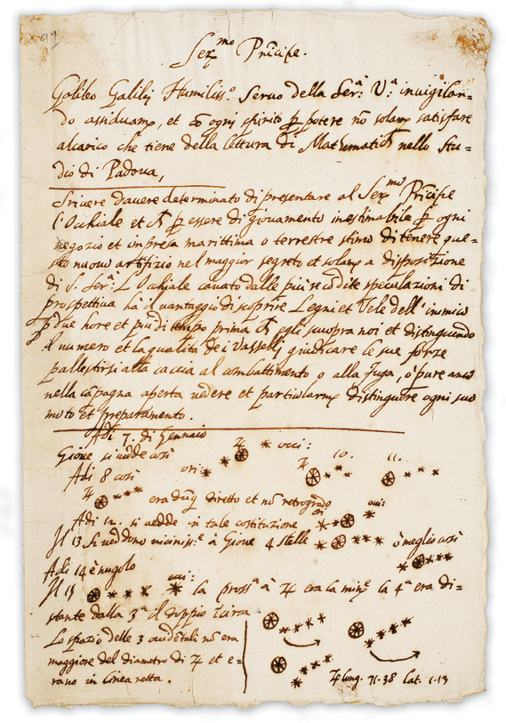
Galileo
University of Michigan
Notes:
A draft letter from Galileo to Leonardo Donato, Doge of Venice in 1609 showing Galileos observations of the Galilean Moons of Jupiter.
Galileo observed craters on the Moon and sunspots on the Sun with his telescopes. He also concluded that some supernova were far enough away that they would not show parallax.
His ideas and observations laid the foundation of modern astronomy.
See: https://www.lib.umich.edu/special-collections-research-center/galileo-manuscript

Slide 19
The Heliocentric Model
Galileo's observations of the phases of Venus and the Galilean moons of Jupiter proved that not everything orbits the Earth
His observations of sunspots and lunar craters proved the heaven was not perfect
He suggested that we couldn’t actually measure stellar parallax yet and that some stars are so distance they have no parallax
Galileo showed that we can move with the motion of the Earth around the sun (as can the moon) without being left behind as Earth moved in its orbit by formulating an early version of Newton’s first law of motion
How does evolution follow the Scientific Method?

Slide 20
The Earth: Orbit
Up next:

